Slide 1
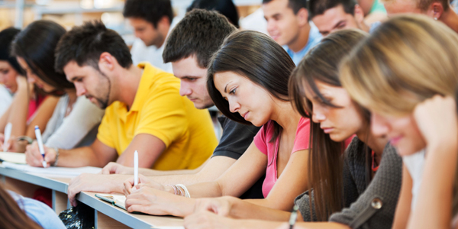
Time’s Up!

Slide 2
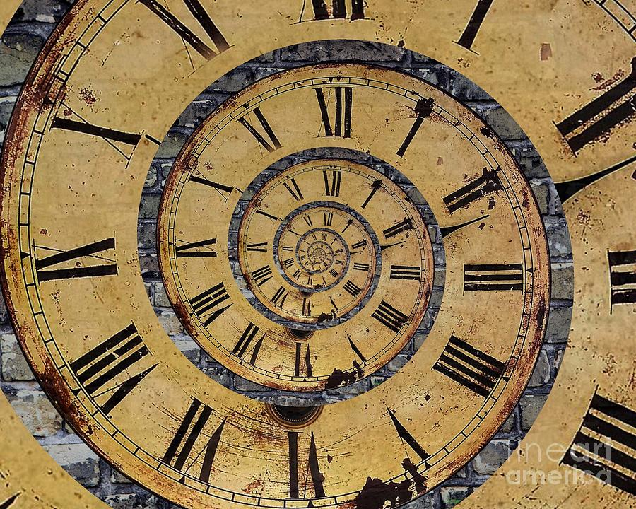

Slide 3
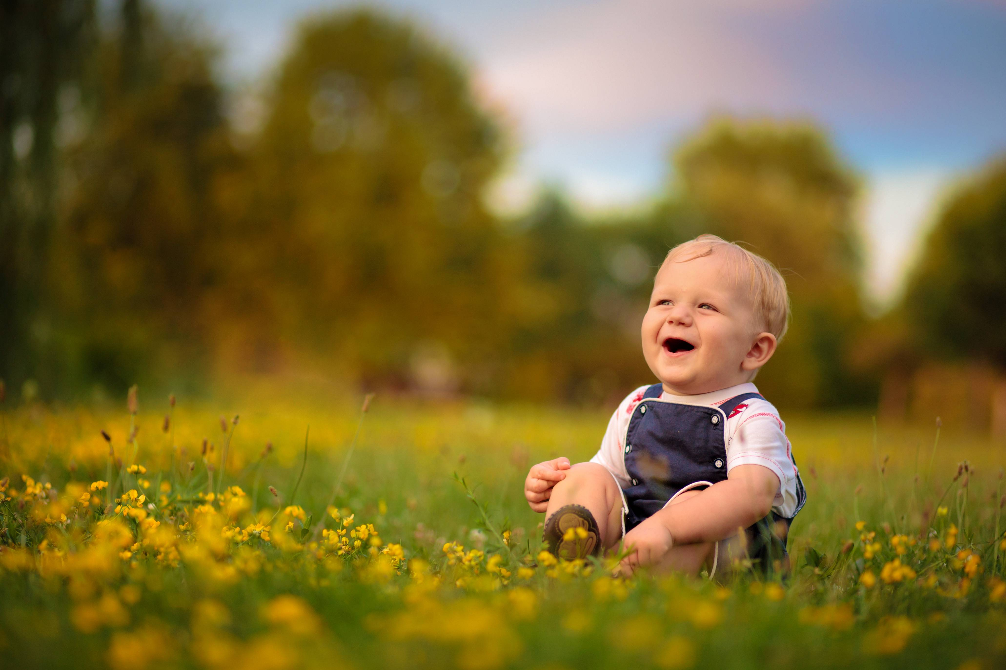
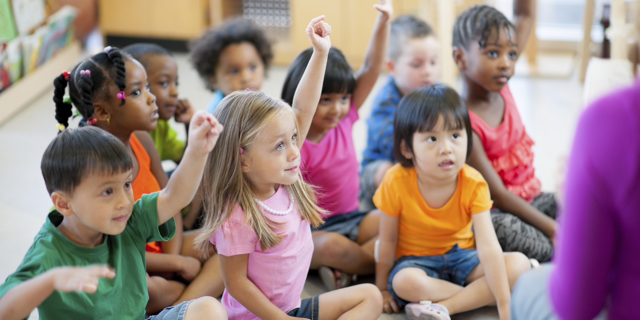
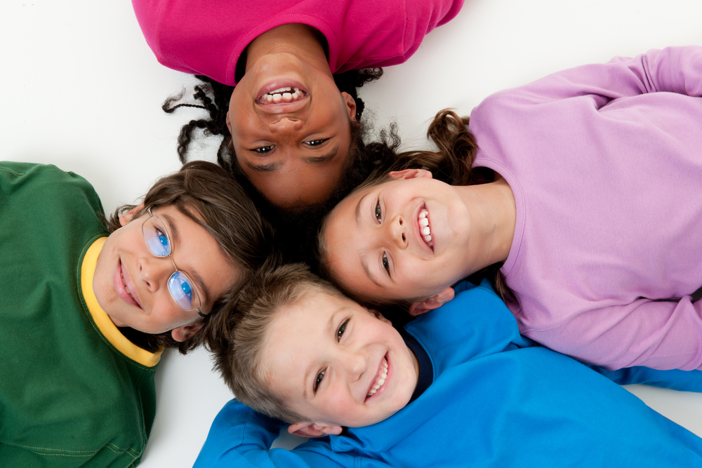
The Drop Box

Slide 4
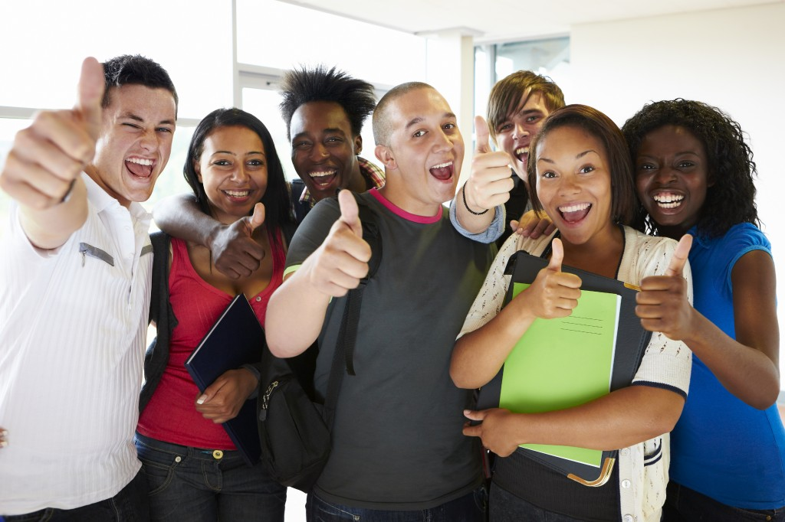
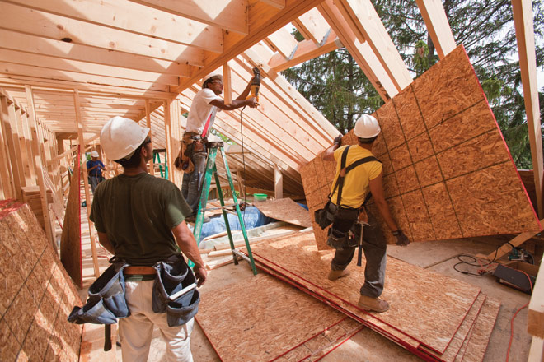

Slide 6
THE ULTIMATE

Slide 7
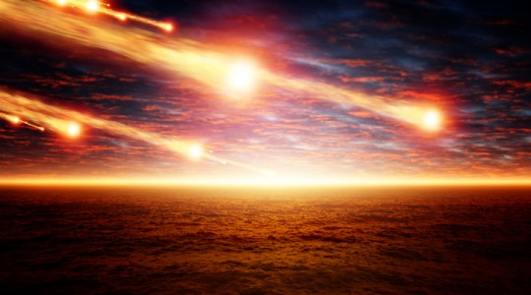

Slide 8
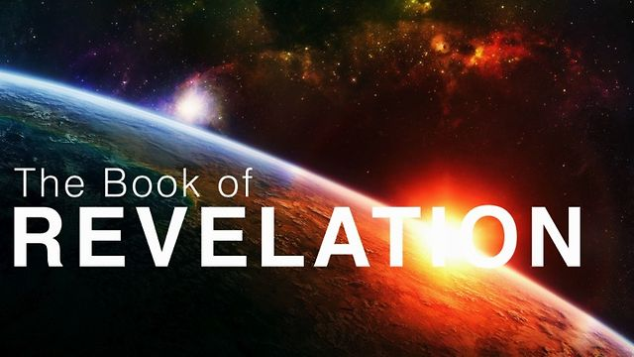

Slide 9
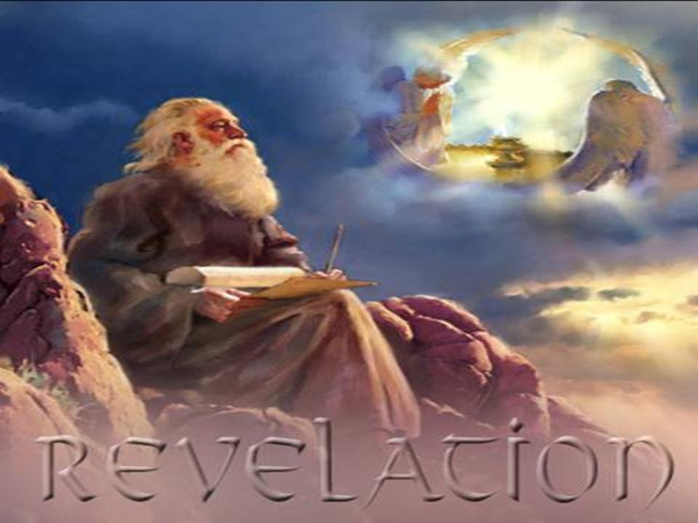

Slide 10
Revelation 1:9 “I, John, your brother and companion in the suffering and kingdom and patient endurance that are ours in Jesus, was on the island of Patmos because of the word of God and the testimony of Jesus.”

Slide 11
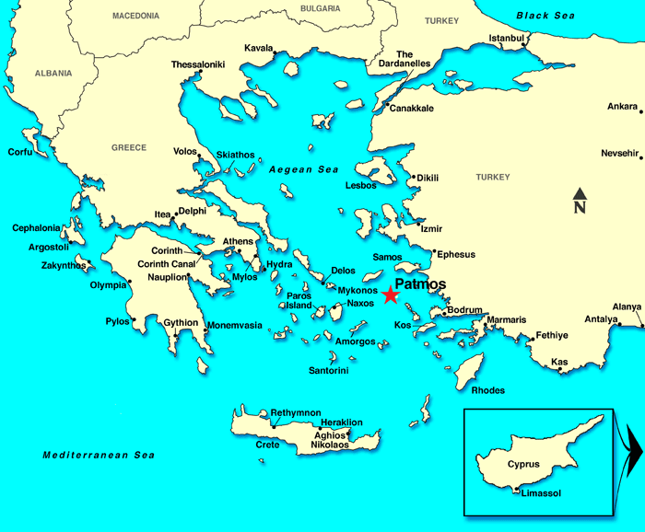

Slide 12
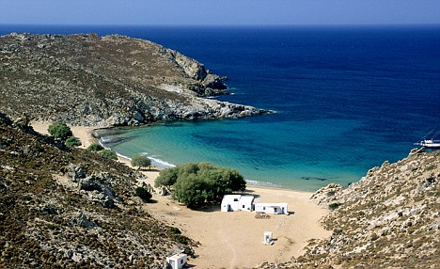

Slide 13
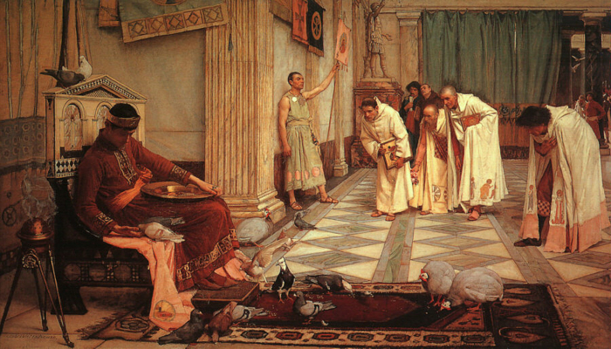
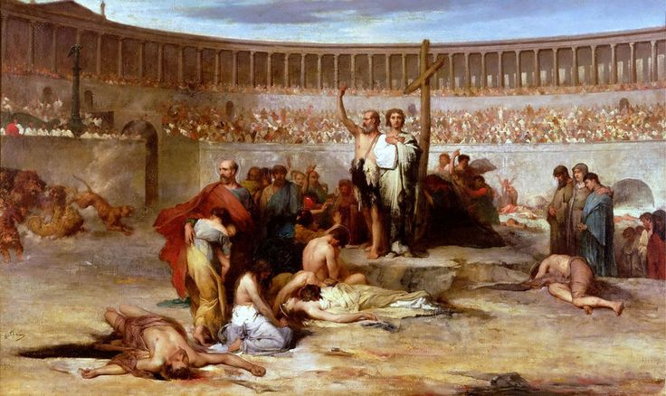
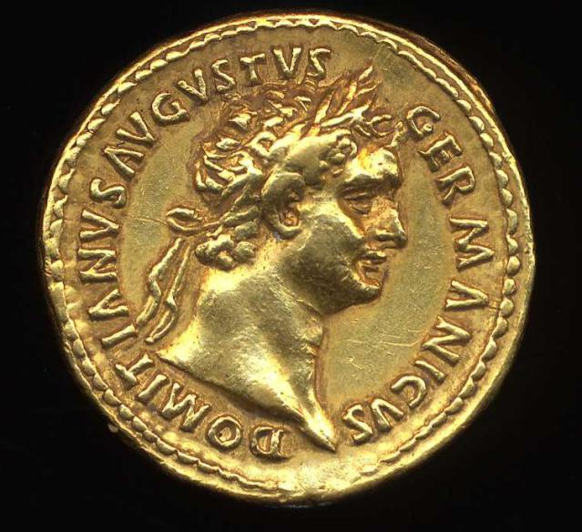

Slide 14
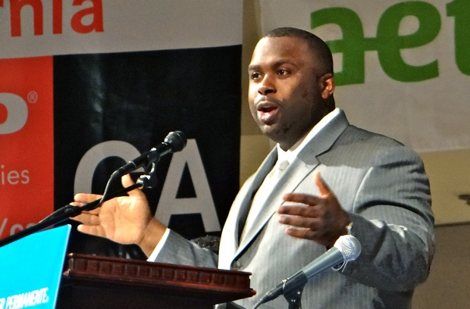
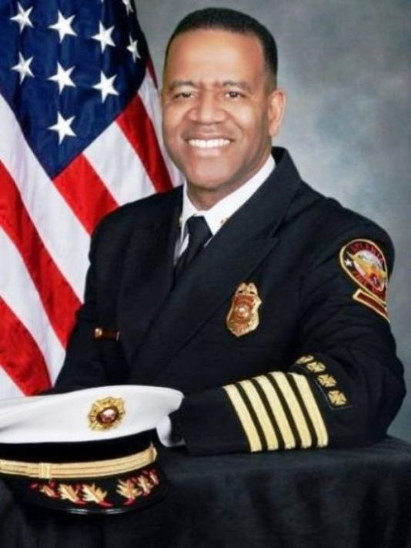
Dr. Eric Walsh
Atlanta Fire Chief
Kelvin Cochran

Slide 15
Revelation 1:9 John was “…[our] brother and companion in the suffering and kingdom and patient endurance that are ours in Jesus….”

Slide 16
We, God’s people, will suffer greatly before Christ returns…so PERSEVERE!

Slide 17
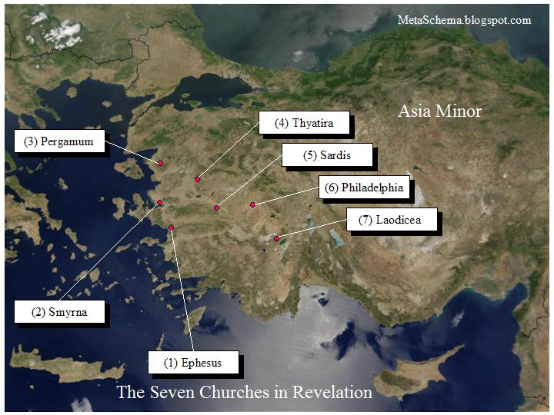

Slide 18
The Church in Ephesus (Revelation 2:1-7) “I know your deeds, your hard work and your perseverance….You have persevered and have endured hardships for my name, and have not grown weary.”

Slide 19
What one life experience are you going through right now that is calling for perseverance and strength?

Slide 20
The Church in Smyrna (Revelation 2:8-11) “I know your affliction and your poverty…I know about the slander [against you]….Do not be afraid of what you are about to suffer. I tell you, the devil will put some of you in prison to test you, and you will suffer persecution…Be faithful, even to the point of death….”

Slide 21
The Church in Pergamum (Revelation 2:12-17) “You remain[ed] true to my name. You did not renounce your faith in me, not even in the days of Antipas, my faithful witness, who was put to death in your city—where Satan lives.”

Slide 22
The Church in Thyatira (Revelation 2:18-29) “I know your…perseverance…. To the one who is victorious and does my will to the end, I will give authority over the nations.”

Slide 23
The Church in Sardis (Revelation 3:1-6)

Slide 24
The Church in Philadelphia (Revelation 3:7-13) “I know that you have little strength, yet you have kept my word and have not denied my name. Since you have kept my command to endure patiently, I will also keep you from the hour of trial that is to come on the whole world to test the inhabitants of the earth. I am coming soon. Hold on to what you have, so that no one will take your crown.”

Slide 25
The Church in Laodicea (Revelation 3:14-22)

Slide 26
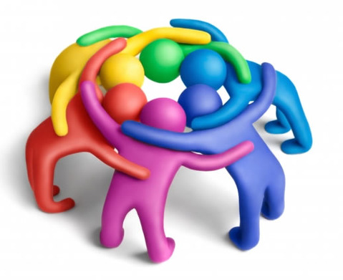
Share (in about 30 seconds each) the “hardship” in which you need perseverance right now.

Slide 27
Now…PRAY!

Slide 28
Revelation 6:9-11 When he opened the fifth seal, I saw under the altar the souls of those who had been slain because of the word of God and the testimony they had maintained. ¹⁰ They called out in a loud voice, “How long, Sovereign Lord, holy and true, until you judge the inhabitants of the earth and avenge our blood?” ¹¹ Then each of them was given a white robe, and they were told to wait a little longer, until the full number of their fellow servants, their brothers and sisters, were killed just as they had been.

Slide 29
Revelation 7:14-17 And he said, “These are they who have come out of the great tribulation; they have washed their robes and made them white in the blood of the Lamb. ¹⁵ Therefore, “they are before the throne of God and serve him day and night in his temple; and he who sits on the throne will shelter them with his presence.

Slide 30
Revelation 7:14-17 ¹⁶ ‘Never again will they hunger; never again will they thirst. The sun will not beat down on them,’ nor any scorching heat. ¹⁷ For the Lamb at the center of the throne will be their shepherd; ‘he will lead them to springs of living water.’ ‘And God will wipe away every tear from their eyes.’”

Slide 31
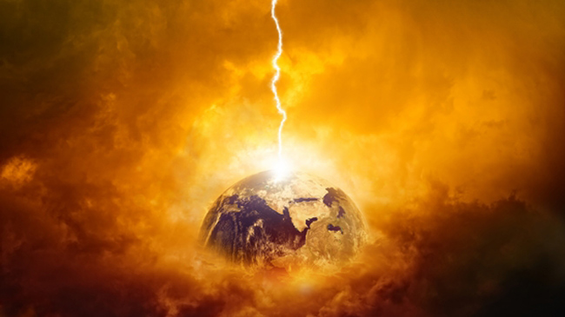
God’s JUDGMENTS will be many and righteous against evil doers

Slide 32
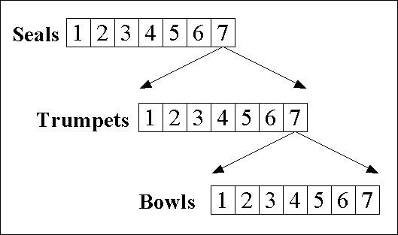

Slide 33
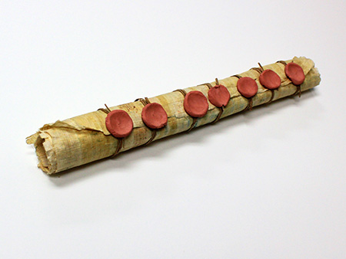
The 7 Seals of Revelation

Slide 34
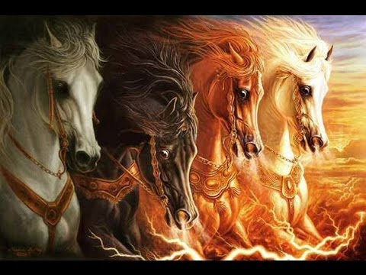

Slide 35
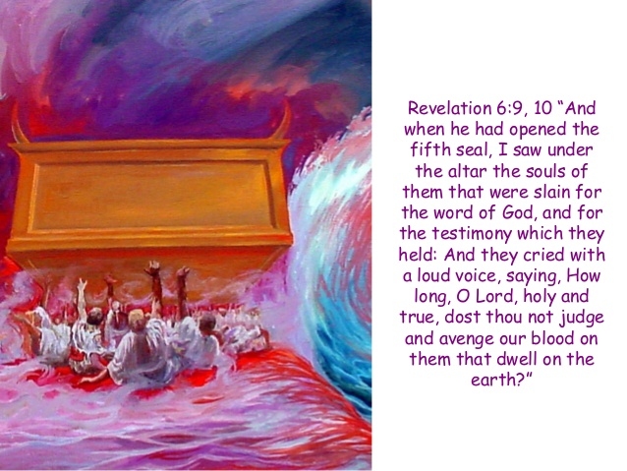

Slide 36
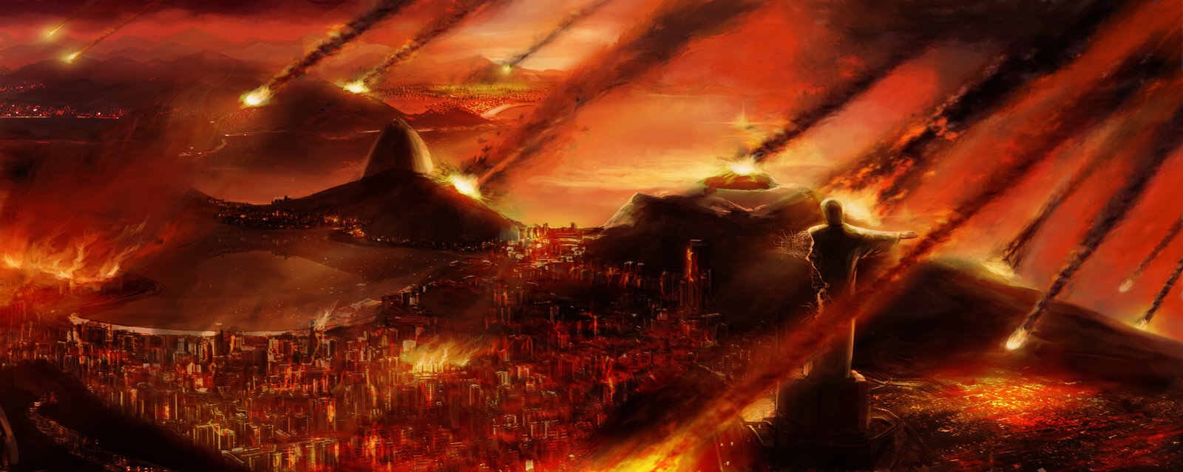
The 6th Seal

Slide 38
Revelation 9:20-21 ²⁰ The rest of mankind who were not killed by these plagues still did not repent of the work of their hands; they did not stop worshiping demons, and idols of gold, silver, bronze, stone and wood—idols that cannot see or hear or walk. ²¹ Nor did they repent of their murders, their magic arts, their sexual immorality or their thefts.

Slide 40
Revelation 14 ¹⁹ The angel swung his sickle on the earth, gathered its grapes and threw them into the great winepress of God’s wrath. ²⁰ They were trampled in the winepress outside the city, and blood flowed out of the press, rising as high as the horses’ bridles for a distance of 1,600 stadia.”

Slide 42
Revelation 16 “You are just in these judgments, O Holy One, you who are and who were; ⁶ for they have shed the blood of your holy people and your prophets, and you have given them blood to drink as they deserve.” ⁷ And I heard the altar respond: “Yes, Lord God Almighty, true and just are your judgments.”

Slide 45
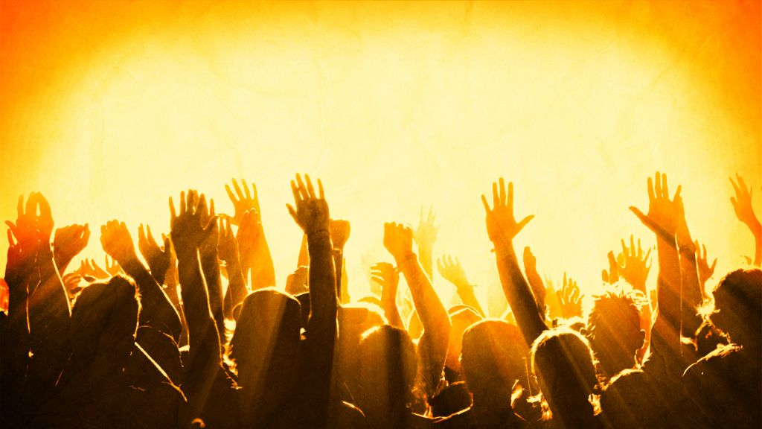
God’s people will experience overwhelming WORSHIP in every age and for all eternity.

Slide 46
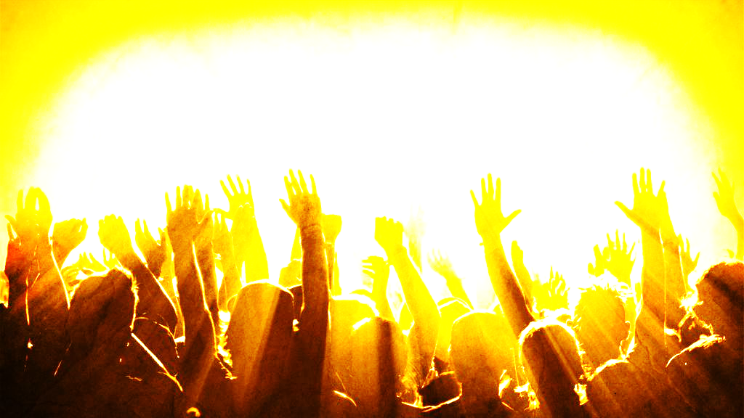
Revelation 1:5-8 To him who loves us and has freed us from our sins by his blood, ⁶ and has made us to be a kingdom and priests to serve his God and Father—to him be glory and power for ever and ever! Amen. ⁷ “Look, he is coming with the clouds,” and “every eye will see him, even those who pierced him”; and all peoples on earth “will mourn because of him.” So shall it be! Amen. ⁸ “I am the Alpha and the Omega,” says the Lord God, “who is, and who was, and who is to come, the Almighty.”

Slide 47
Revelation 4:2-11 ² At once I was in the Spirit, and there before me was a throne in heaven with someone sitting on it. ³ And the one who sat there had the appearance of jasper and ruby. A rainbow that shone like an emerald encircled the throne. ⁴ Surrounding the throne were twenty-four other thrones, and seated on them were twenty-four elders. They were dressed in white and had crowns of gold on their heads. ⁵ From the throne came flashes of lightning, rumblings and peals of thunder. In front of the throne, seven lamps were blazing. These are the seven spirits of God.

Slide 48
Revelation 4:2-11 ⁶ Also in front of the throne there was what looked like a sea of glass, clear as crystal. In the center, around the throne, were four living creatures, and they were covered with eyes, in front and in back. Day and night they never stop saying: “‘Holy, holy, holy is the Lord God Almighty,’ who was, and is, and is to come.” ⁹ Whenever the living creatures give glory, honor and thanks to him who sits on the throne and who lives for ever and ever, ¹⁰ the twenty-four elders fall down before him who sits on the throne and worship him who lives for ever and ever. They lay their crowns before the throne and say:

Slide 49
Revelation 4:2-11 ¹¹ “You are worthy, our Lord and God, to receive glory and honor and power, for you created all things, and by your will they were created and have their being.”

Slide 50
Revelation 5:8-14 “And when he [the Lamb] had taken it [the scroll], the four living creatures and the twenty-four elders fell down before the Lamb. Each one had a harp and they were holding golden bowls full of incense, which are the prayers of God’s people. ⁹ And they sang a new song, saying: “You are worthy to take the scroll and to open its seals, because you were slain, and with your blood you purchased for God persons from every tribe and language and people and nation.

Slide 51
Revelation 5:8-14 ¹⁰ You have made them to be a kingdom and priests to serve our God, and they will reign on the earth.” ¹¹ Then I looked and heard the voice of many angels, numbering thousands upon thousands, and ten thousand times ten thousand. They encircled the throne and the living creatures and the elders. ¹² In a loud voice they were saying: “Worthy is the Lamb, who was slain, to receive power and wealth and wisdom and strength and honor and glory and praise!”

Slide 52
Revelation 5:8-14 ¹³ Then I heard every creature in heaven and on earth and under the earth and on the sea, and all that is in them, saying: “To him who sits on the throne and to the Lamb be praise and honor and glory and power, for ever and ever!” ¹⁴ The four living creatures said, “Amen,” and the elders fell down and worshiped.

Slide 53
Rev. 22:1-5 Then the angel showed me the river of the water of life, as clear as crystal, flowing from the throne of God and of the Lamb ² down the middle of the great street of the city. On each side of the river stood the tree of life, bearing twelve crops of fruit, yielding its fruit every month. And the leaves of the tree are for the healing of the nations. ³ No longer will there be any curse. The throne of God and of the Lamb will be in the city, and his servants will serve him. ⁴ They will see his face, and his name will be on their foreheads. ⁵ There will be no more night. They will not need the light of a lamp or the light of the sun, for the Lord God will give them light. And they will reign for ever and ever.

Slide 54
Rev. 22:1-5 ⁶ The angel said to me, “These words are trustworthy and true. The Lord, the God who inspires the prophets, sent his angel to show his servants the things that must soon take place.” ⁷ “Look, I am coming soon! Blessed is the one who keeps the words of the prophecy written in this scroll.” ⁸ I, John, am the one who heard and saw these things. And when I had heard and seen them, I fell down to worship at the feet of the angel who had been showing them to me. ⁹ But he said to me, “Don’t do that! I am a fellow servant with you and with your fellow prophets and with all who keep the words of this scroll. Worship God!”

Slide 55
Worship God always.
Take comfort in His justice.
Persevere in sufferings.

